Slide 1
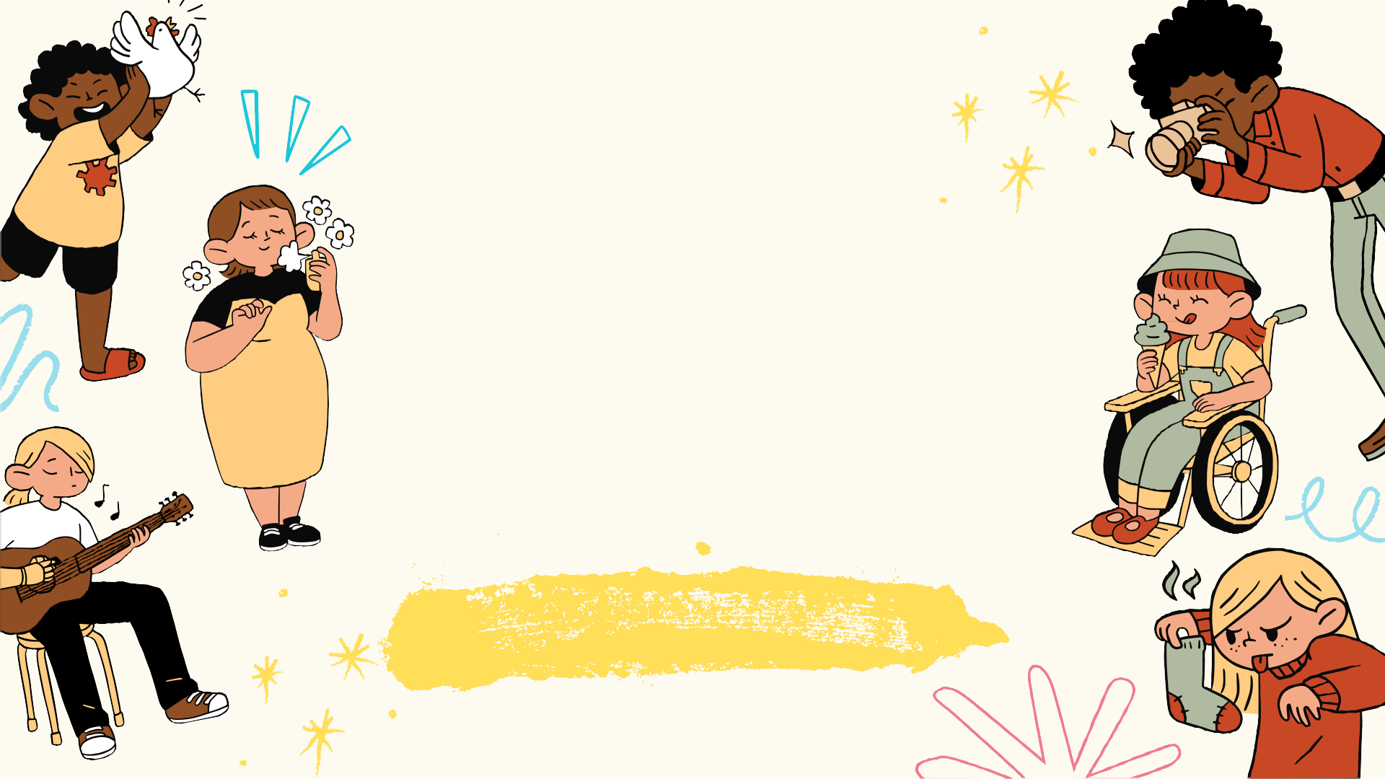
WEEK 4 : DANCE TERMS
PRESENTED BY: LONOZA, ALCAIDE, CABUDSAN, DALUGDOG,NAMIAS,
PALOMARES

Slide 2
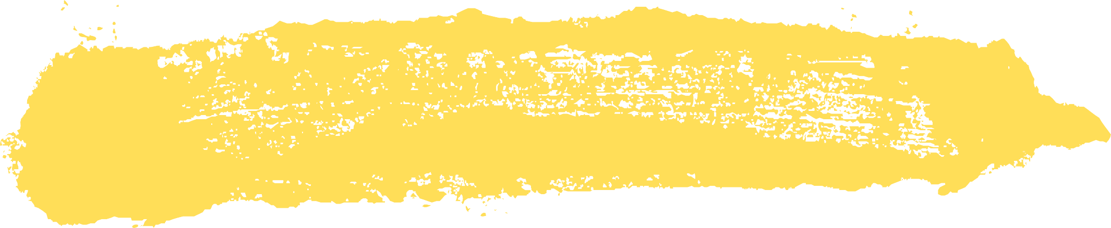
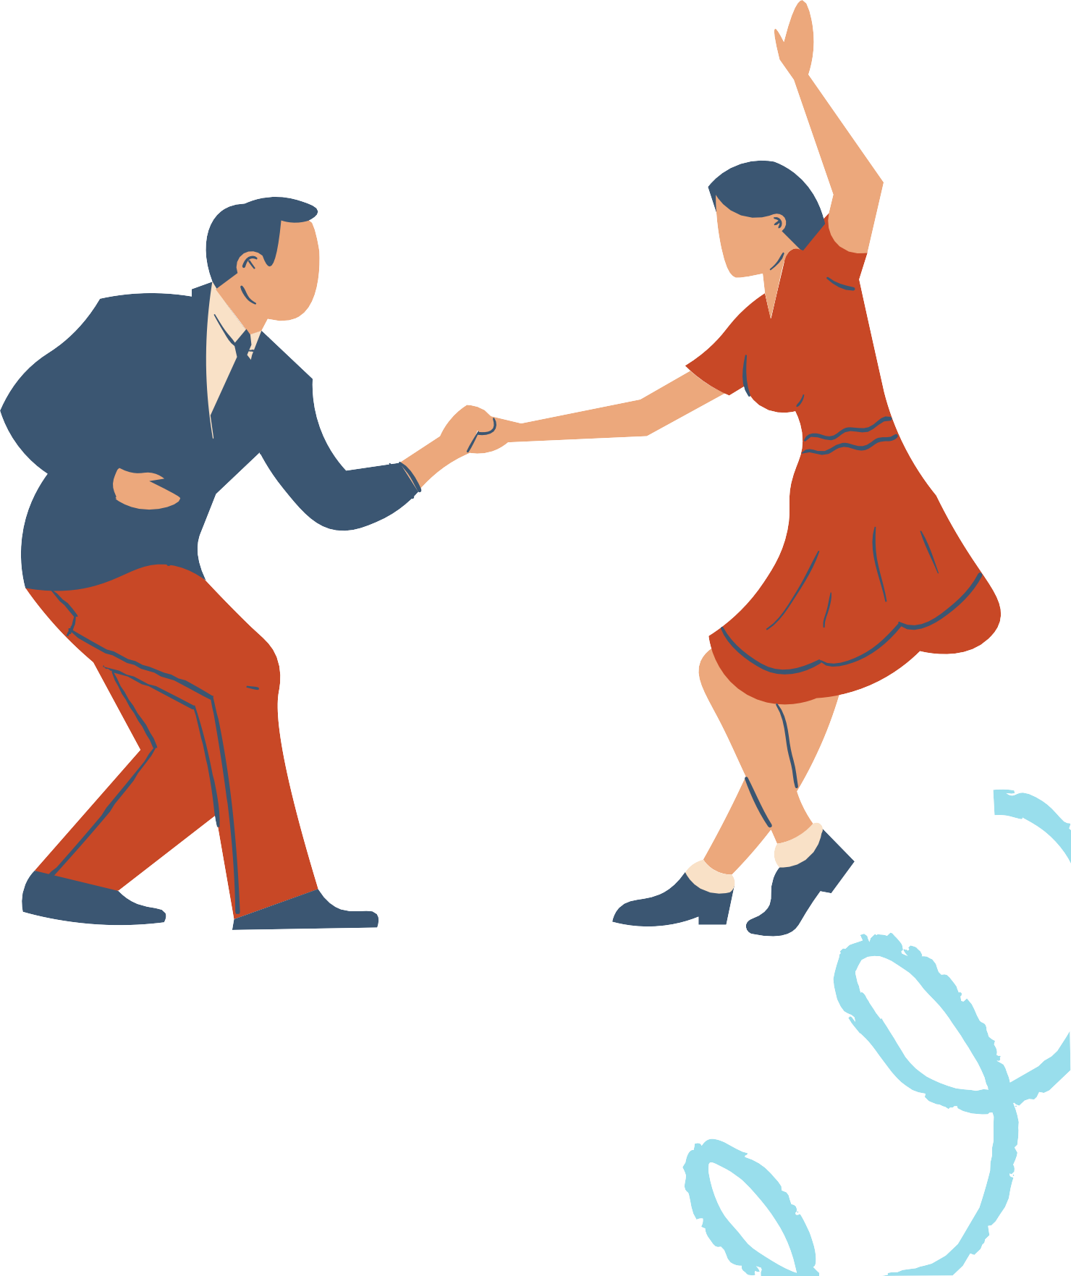

INTRODUCTION
Folk Dance emerges as a dance style crafted by a community, mirroring the conventional lifestyle of a specific nation or locality. This week topic will center on the common dance terms in Philippine Folk dance and Common Dance Terms.

Slide 3
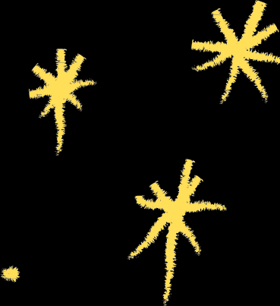

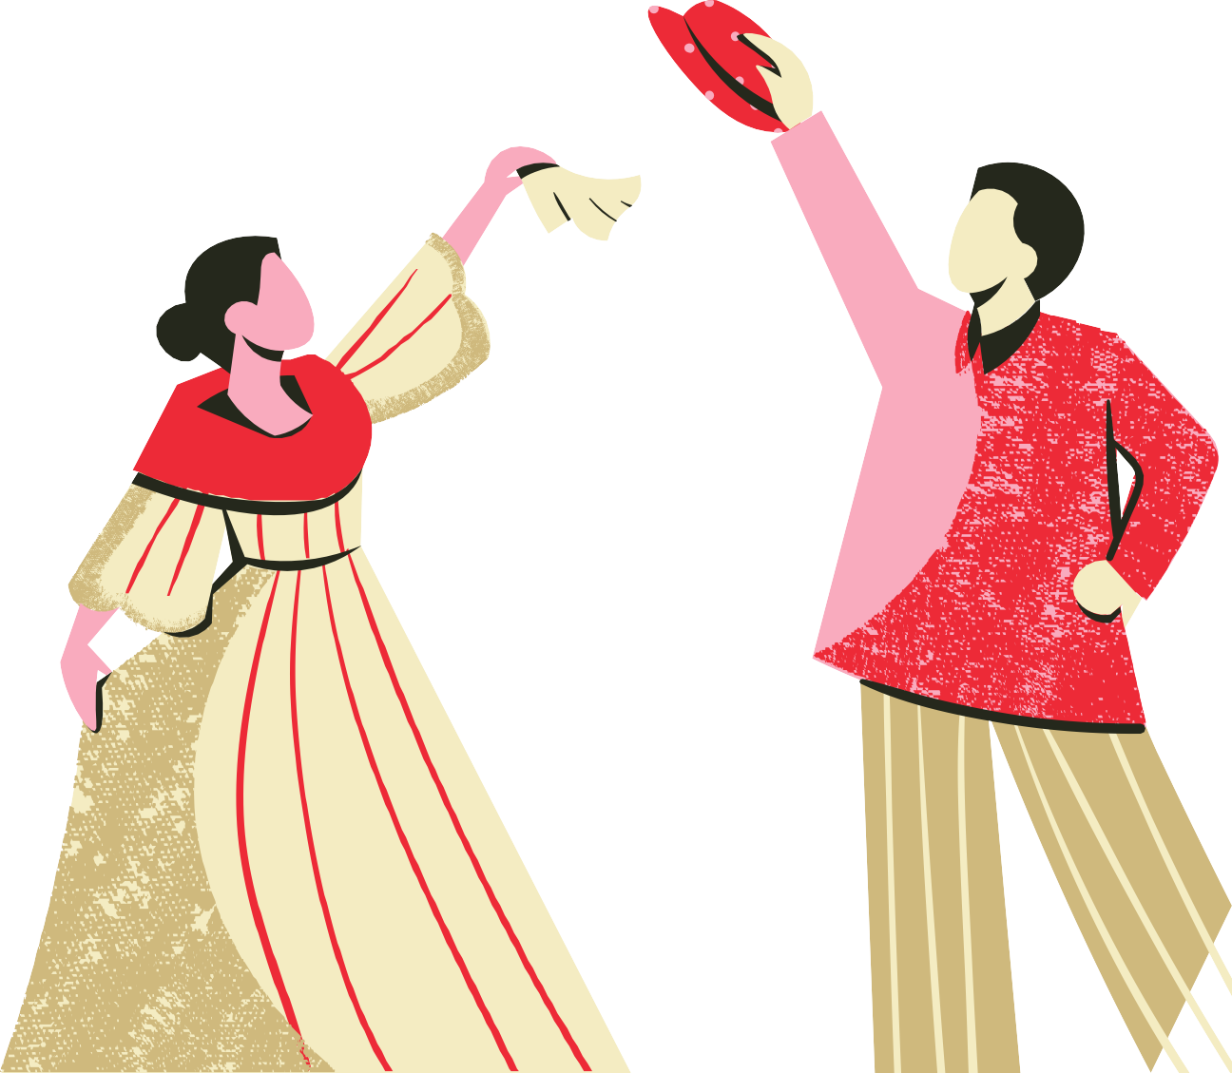
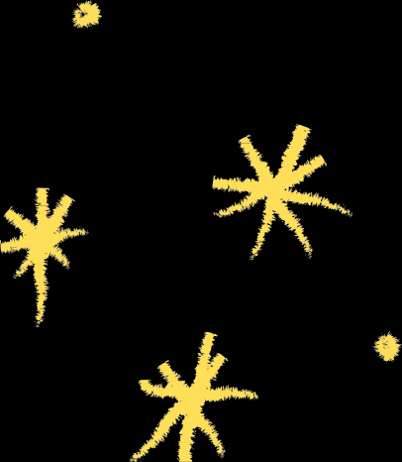
COMMON DANCE TERMS IN PHILIPPINE FOLK DANCE

Slide 4


ABRACETE/ ABRASETE
Girl at the right side, holds Right arm of partner with her Left hand, free hands down at the sides. This term is of Spanish and is used in Rigodon and in other dances.

Slide 5


ARMS IN LATERAL POSITION
both arms are at one side, either sideward right or left. This may be done at shoulder chest or waist level

Slide 6

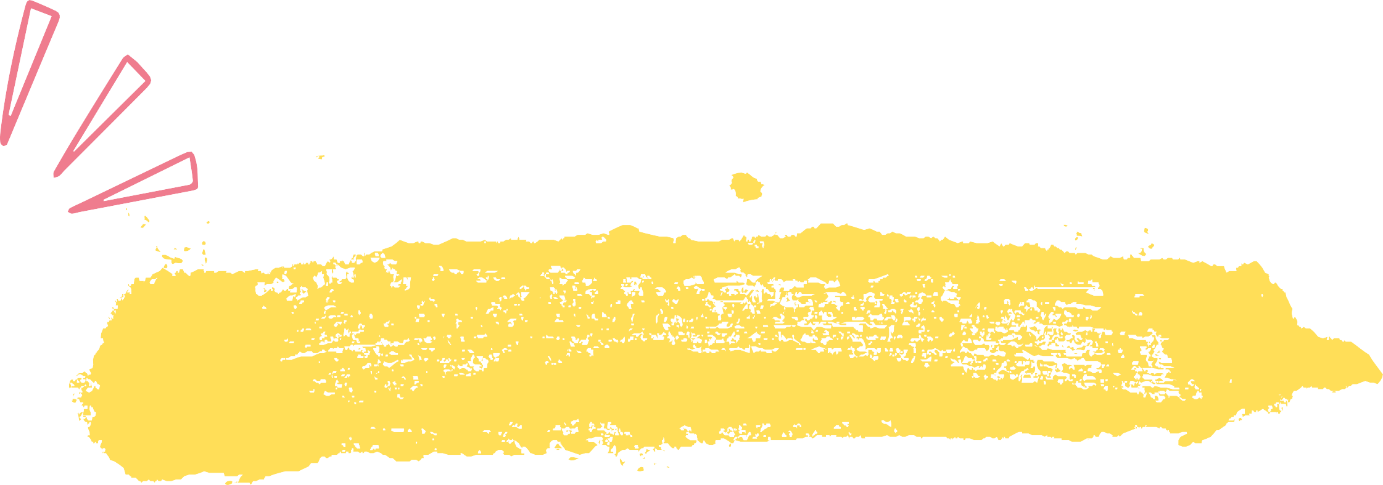
ARMS IN REVERSE T -POSITION
Arms are side horizontal, elbows bent at right angles, forearms parallel to head, palms forward or facing inward, fists loosely closed

Slide 7


BILAO
To turn hands up and down alternately, hands at waist level in front, elbows close to waist.

Slide 8


BRUSH
Weight on one foot, hit the floor with the ball or heel of the other foot (the
free foot) after which that foot is lifted from the floor to any direction.

Slide 9


CABECERAS
When dancers are in square formation, the couples occupying thewidth of the hall are called "cabeceras" or head couples. This is of Spanish origin.

Slide 10

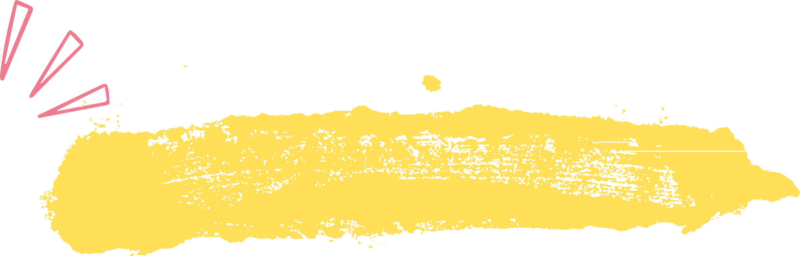
CLOCKWISE
Like the motion of the hands of the clock. Right shoulder is toward the center of an imaginary circle. When facing the center, the movement is toward the left.

Slide 11

COUNTER CLOCK WISE
The reverse direction of clockwise. Left shoulder is toward the center of an imaginary circle. When facing the center, the movement is toward the right.

Slide 12


COSTADOS
When Dancers are in square formation, the couples occupying thelength of the hall are called "costados" or side pairs. This is of Spanish origin

Slide 13


CROSSED ARMS
Partners are facing each other or standing side by side, girl at theright of boy. They join their Left hands together and their Right hands together either Right over Left or Left over Right hands

Slide 14

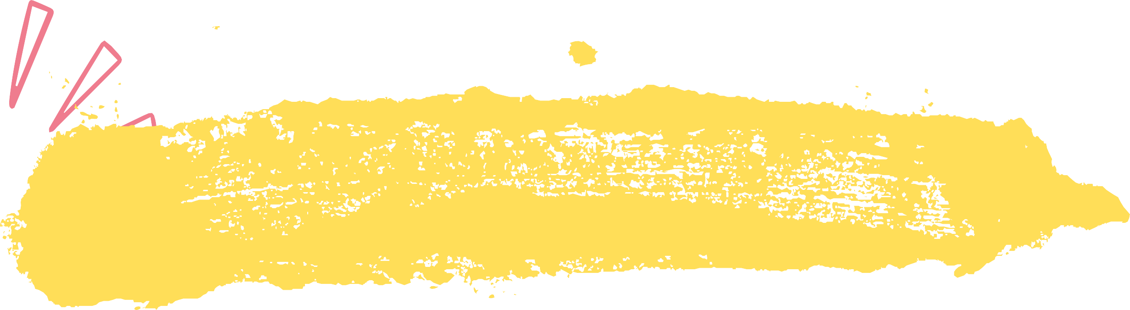
CROSSOVER
Two couples (the vis-à-vis) are opposite each other. Each coupleproceeds in a straight line to the opposite place. The girl passes by their Leftshoulders between the boys. Boys bow to each other when they meet at the middleor at about one-third of the way, then proceed to the opposite place. Upon reachingthe opposite place, partners turn about, girls stand at partners’ right side

Slide 15
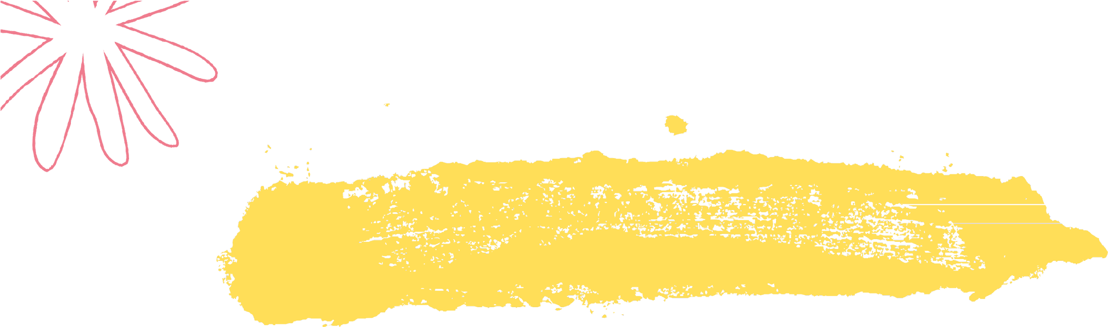
CUT
To displace quickly one foot with the other, thus completely taking off the weight of the body from the displaced foot

Slide 16


MASIWAK
to turn the hand from the wrist halfway clockwise, then raise and lower wrist once or twice.

Slide 17

DRAW
To pull one foot along the floor close to the other which has the weight ofthe body The weight may or may not be transferred.

Slide 18

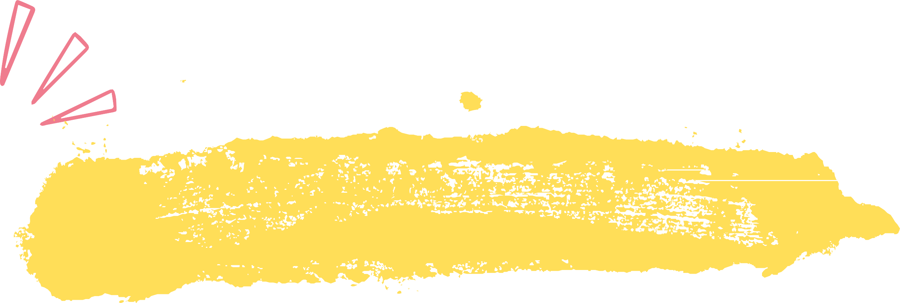
HAND ON WAIST
Place hands at the waist line (at the smallest part of the trunk),knuckles in, fingers pointing in rear.

Slide 19

HAPAY
To flourish or offer a handkerchief, hat or glass of wine to somebody as asign of invitation

Slide 20


HOP
a spring from one foot-landing on the other foot in place or in any direction.

Slide 21

KUMINTANG
moving the hand from the wrist either in a clockwise or counter clockwise direction.

Slide 22


SLIDE
to glide foot smoothly along the floor

Slide 23
SAROK
cross the R(or L) foot infront of the L (or R) bent the body slightly forward and cross hands down in front with the R (or L) hand over the L (or R)

Slide 24
POINT
touch the floor lightly with the toes of one foot, weight of the body on the other foot.

Slide 25
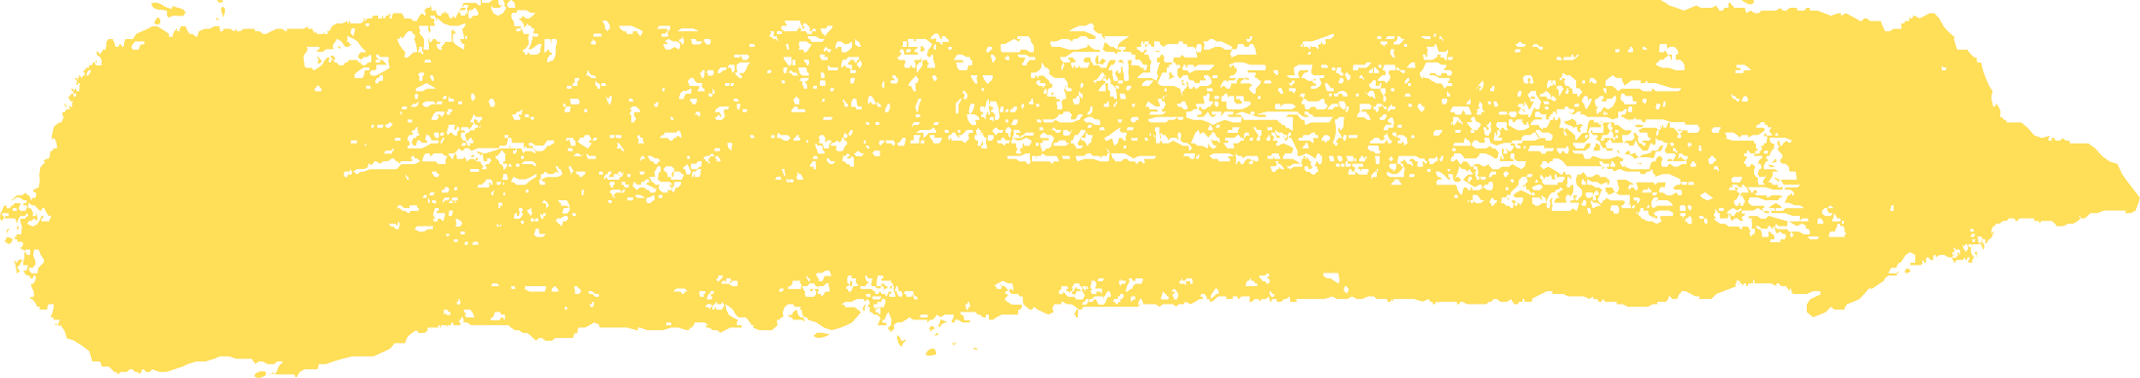


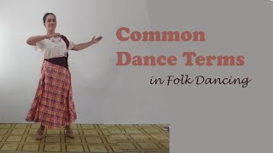
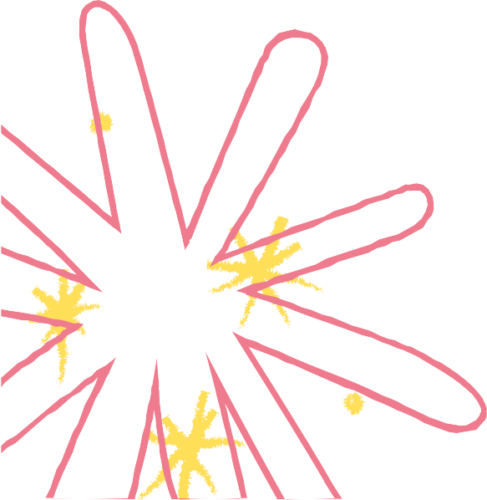


Slide 26
COMMON DANCE FORMATIONS

Slide 27
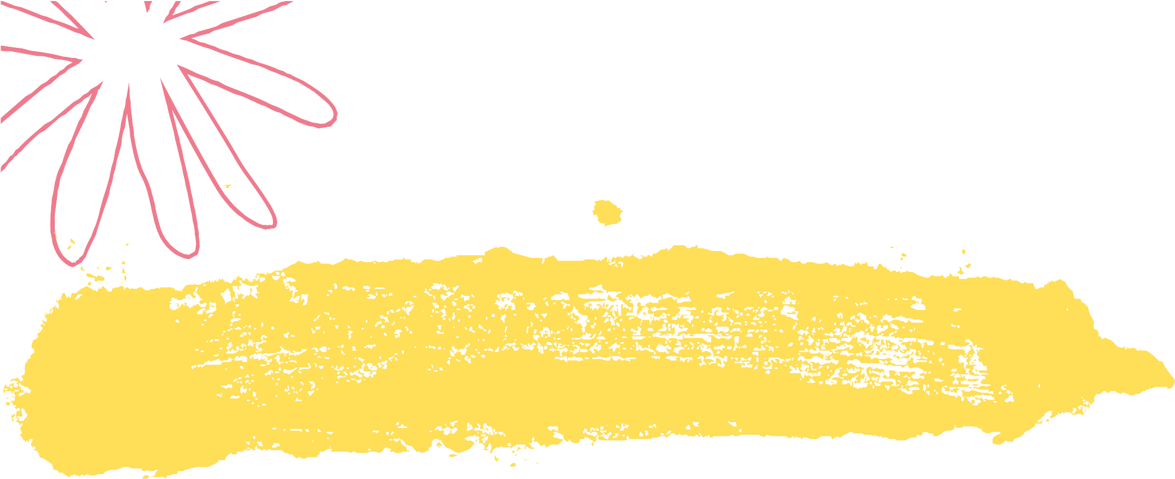
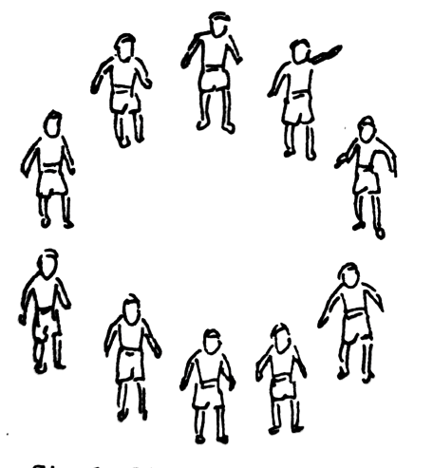
SINGLE CIRCLE FORMATION
A single circle formation in dance refers to a choreographic arrangement where dancers stand in a circular arrangement, typically facing the center of the circle.

Slide 28

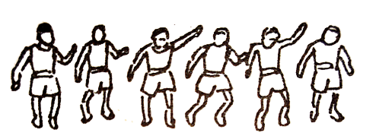
LINE FORMATION
A line formation in dance refers to a choreographic arrangement where dancers are positioned in a straight line, typically facing the same direction. This formation can be either horizontal, with dancers lined up side by side, or vertical, with dancers lined up front to back.

Slide 29
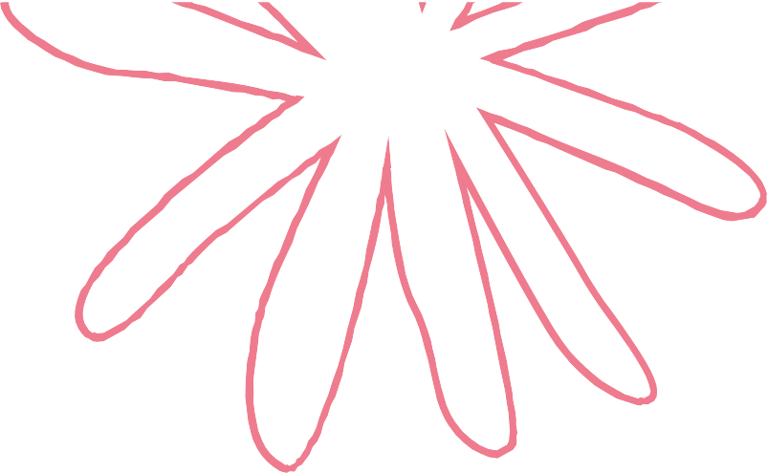

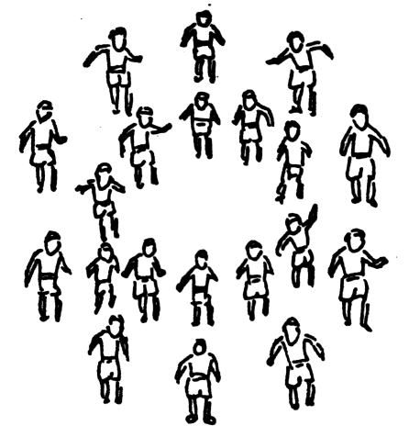
DOUBLE CIRCLE FORMATION
Similar to the single circle formation, but with two concentric circles of dancers. This can create opportunities for interactions between the inner and outer circles.

Slide 30
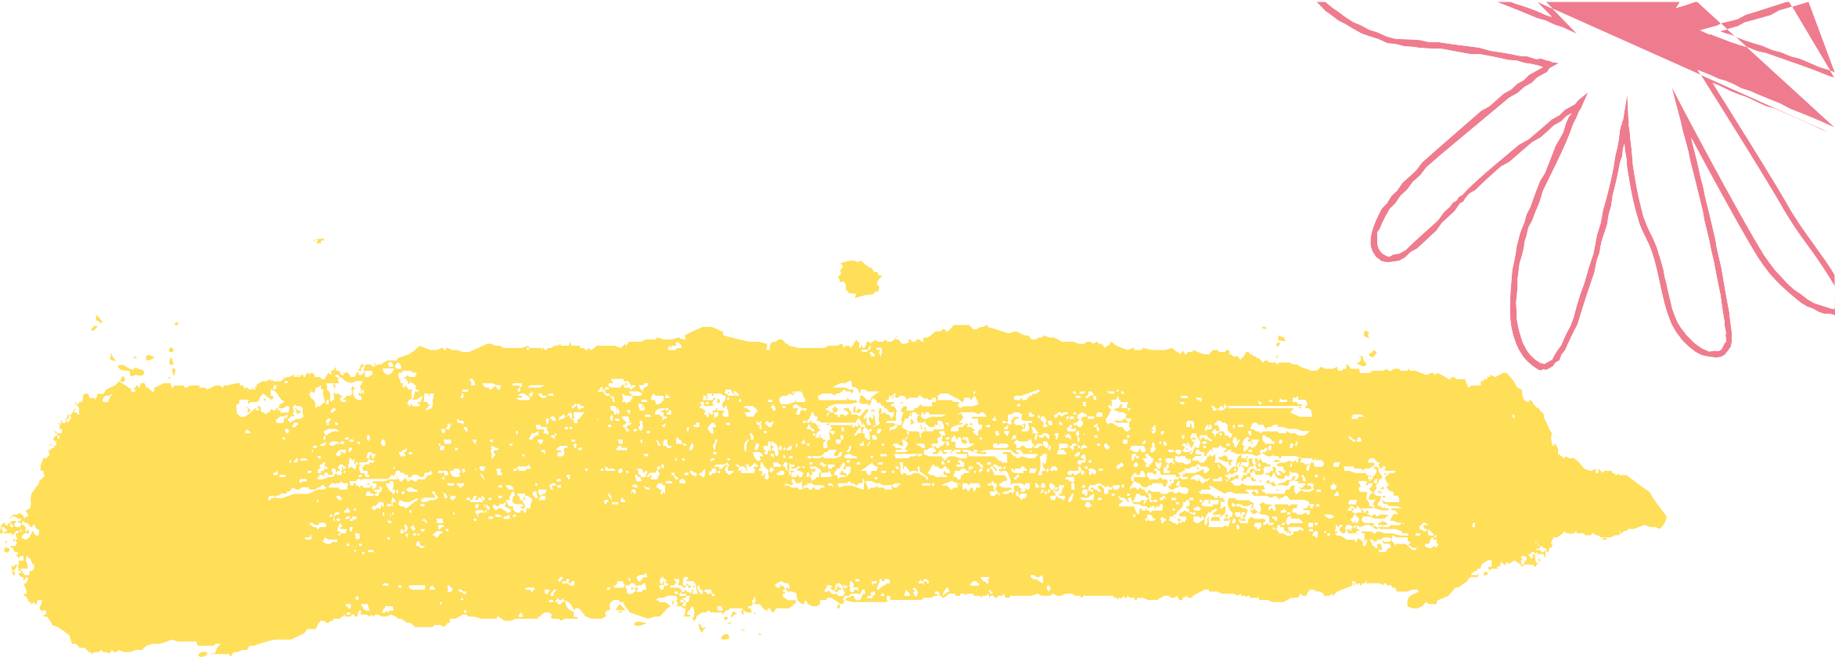
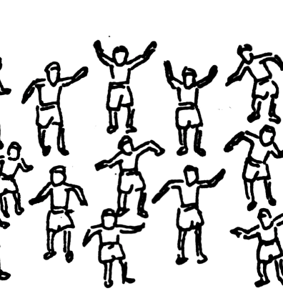
SCATTERED FORMATION
Dancers are positioned in a more scattered or irregular pattern, allowing for individual movements and interactions.

Slide 31

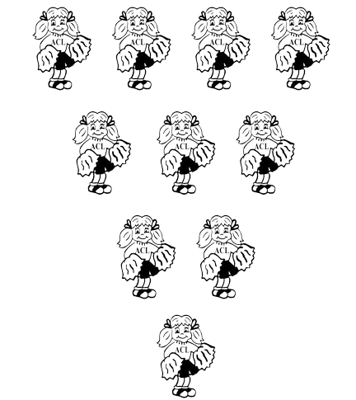
V-SHAPED FORMATION
Dancers are arranged in the shape of a "V," with one dancer at the front point and the others fanning out behind them.

Slide 32


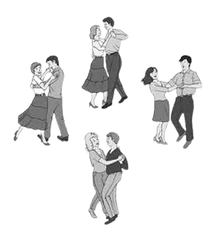

BOX FORMATION
Box or Square Formation: Dancers form the corners of a square or rectangle, creating clean lines and right angles.

Slide 33

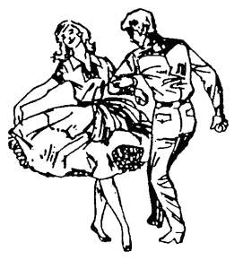


PARTNER FORMATION
Dancers are paired up, often facing each other or working in tandem. This formation is common in partner dances like waltz or tango.

Slide 34


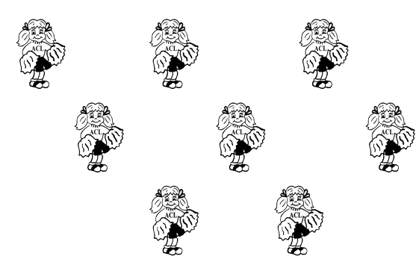


WINDOW FORMATION
The "window" dance formation is a specific arrangement where dancers are positioned in a way that resembles the panes of a window frame.

Slide 35
